Slide 1
TUT05 – Machine Language COMP1411: Introduction to Computer Systems
Dr. Mingsong LYU
Department of Computing
The Hong Kong Polytechnic University
Spring 2023
These slides are only intended to use internally. Do not publish it anywhere without permission.

Slide 2
Question 1
Suppose we have the following C code
int comp(data_t a, data_t b) {
return a COMP b; }
Suppose that a is stored in some portion of register %rdi, and b is stored in some portion of register %rsi. The return value is stored in register %al.
For each case below, infer the data type data_t (e.g., char, short, int, long, their unsigned versions) and the comparison operator COMP (e.g., <, >, ==, >=, <=, !=)
 | Assembly code | Data type data_t | Comparison operator COMP
Case 1 | cmpl %esi, %edi setl %al | ? | ?
Case 2 | cmpw %si, %di setge %al | ? | ?
Case 3 | cmpb %sil, %dil setbe %al | ? | ?

Slide 3
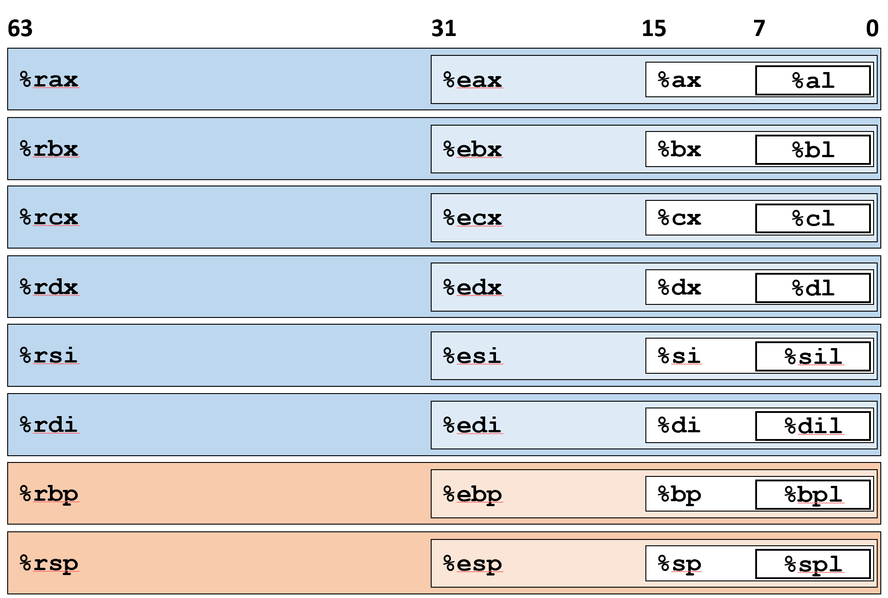
Question 1
 | Assembly code | Data type data_t | Comparison operator COMP
Case 1 | cmpl %esi, %edi setl %al
Case 2 | cmpw %si, %di setge %al
Case 3 | cmpb %sil, %dil setbe %al
a COMP b
int
a < b
Variable | register
a | %rdi
b | %rsi
Return val | %al
short
a >= b
unsigned char
a <= b
SetX | Condition | Description
sete | ZF | Equal / Zero
setne | ~ZF | Not Equal / Not Zero
sets | SF | Negative
setns | ~SF | Nonnegative
setg | ~(SF^OF)&~ZF | Greater (Signed)
setge | ~(SF^OF) | Greater or Equal (Signed)
setl | (SF^OF) | Less (Signed)
setle | (SF^OF)|ZF | Less or Equal (Signed)
seta | ~CF&~ZF | Above (unsigned)
setb | CF | Below (unsigned)

Slide 4
Question 2
Convert the following C function to assembly code.
long long func(long long a, long long b) {
long long result = b;
while (b>0) {
result = result * a;
b = b - a;
}
return result;
}
Assume that a, b, result are stored in registers %rdi, %rsi, %rax, respectively.

Slide 5
Question 2
fun:
movq %rsi, %rax # result = b
L2:
cmpq $0, %rsi # compare b and 0
jg L3 # if (b>0) goto L3
ret # return result
L3:
imulq %rdi, %rax # result = result * a
subq %rdi, %rsi # b = b - a
jmp L2 # goto L2
long long fun
(long long a, long long b) {
long long result = b;
while (b>0) {
result = result * a;
b = b - a;
}
return result;
}
Variable | register
a | %rdi
b | %rsi
result | %rax

Slide 6
Question 3
In the following C function, the definition of operation OP is missing.
# define OP __________
long arith(long x) {
return x OP 8; }
After compilation, we obtain the following assembly code.
arith:
movq %rdi, %rax
addq $7, %rax
testq %rdi, %rdi
cmovns %rdi, %rax
sarq $3, %rax
ret
Suppose that x is stored in register %rdi
(a) What operation is OP?
(b) Explain the assembly code

Slide 7
Question 3
==> t = x, t in %rax
movq %rdi, %rax
addq $7, %rax
testq %rdi, %rdi
cmovns %rdi, %rax
sarq $3, %rax
==> t = t + 7
==> x & x, set conditional codes
==> if (x&x >= 0), t = x
==> t = t >> 3 (t = t / 8)
5-bit signed | value | >>3 | value | Target
11111 | -1 | 11111 | -1 | 0
11110 | -2 | 11111 | -1 | 0
11101 | -3 | 11111 | -1 | 0
11100 | -4 | 11111 | -1 | 0
11011 | -5 | 11111 | -1 | 0
11010 | -6 | 11111 | -1 | 0
11001 | -7 | 11111 | -1 | 0
11000 | -8 | 11111 | -1 | -1

Slide 8
Thank You

